Slide 1
Neighbourhood Health Services
Reading Patient Voice Group
15th October 2025
Kathryn MacDermott, Director of Strategic Planning
Kathryn.macdermott@berkshire.nhs.uk

Slide 2
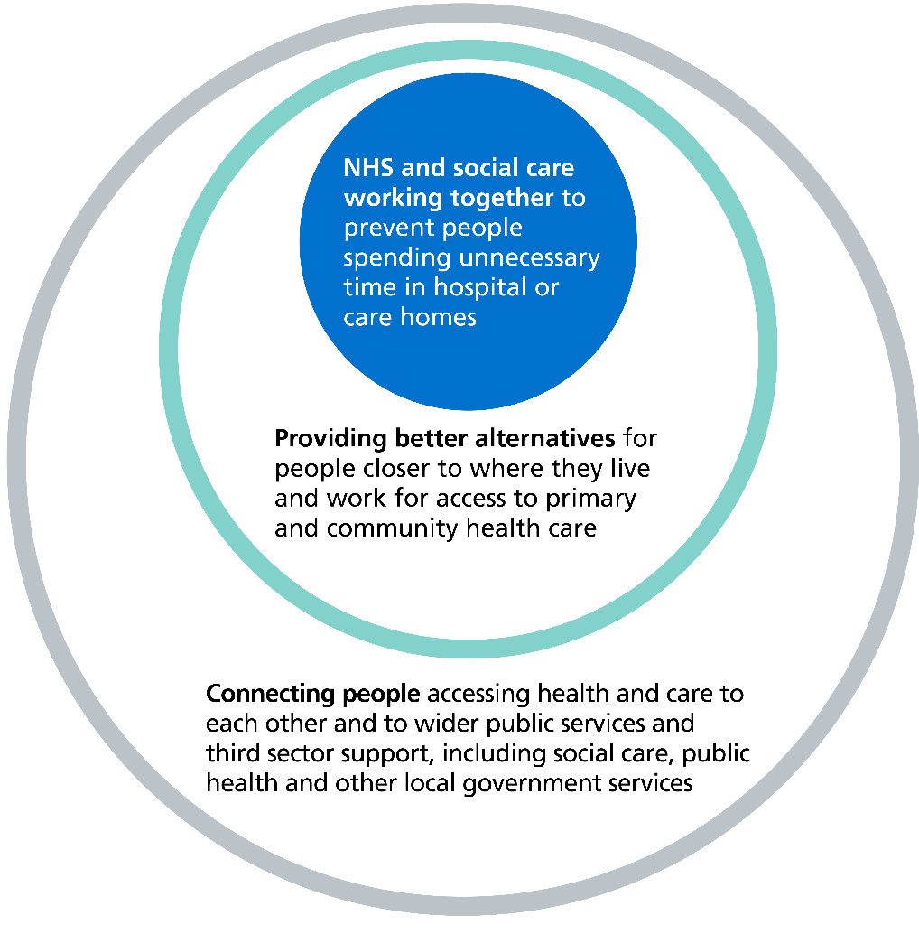
Neighbourhood Health Services
Neighbourhood Health Services are a key component of the 10 Year Health Plan.
The aim is to “create healthier communities, helping people of all ages live healthy, active and independent lives for as long as possible while improving their experience of health and social care” through better connecting health services and health and social care services and optimising health and care resource.
It is a key element of the ‘three left shifts”:
from hospital to community – providing better care close to or in people’s own homes, helping them to maintain their independence for as long as possible, only using hospitals when it is clinically necessary for their care
from treatment to prevention – promoting health literacy, supporting early intervention and reducing health deterioration or avoidable exacerbations of ill health
from analogue to digital – greater use of digital infrastructure and solutions to improve care
The 10 Year Health plan can be found here: 10 Year Health Plan
Visual of the aims 5 to 10 years

Slide 3
Neighbourhood health services include:
Modern general practice
Standardising community health services
Integrated intermediate care with a ‘Home First’ approach
Population health management
Urgent neighbourhood services
Neighbourhood multidisciplinary teams (MDTs)
We are adding community engagement, data, finance, and leadership development to the nationally required components

Slide 4

Neighbourhood Health Vision (draft)
Residents in Berks West, will be enabled to improve their health and wellbeing holistically via world class neighbourhood based care. Focused on the whole person, a prevention-centred approach supporting seamless access to care, rooted in communities.
Holistic health & wellbeing for residents
World-class neighbourhood care
Prevention-centred, de-medicalised approach
Seamless, community-rooted services

Slide 5

How neighbourhood working benefits people
FRAGMENTED CARE
JOINED UP CARE
Before
LONGER WAITS
FASTER, EASIER ACCESS
GENERIC TREATMENT
PERSONALISED COMMUNITY ROOTED SUPPORT
After
CRISIS
PREVENTION & INDEPENDENCE
BETTER OUTCOMES, BETTER EXPERIENCE
Notes:
King’s fund article with lots of case studies.
Delivering a neighbourhood health service: what the 10 Year Health Plan means for local integration | NHS Confederation

Slide 6
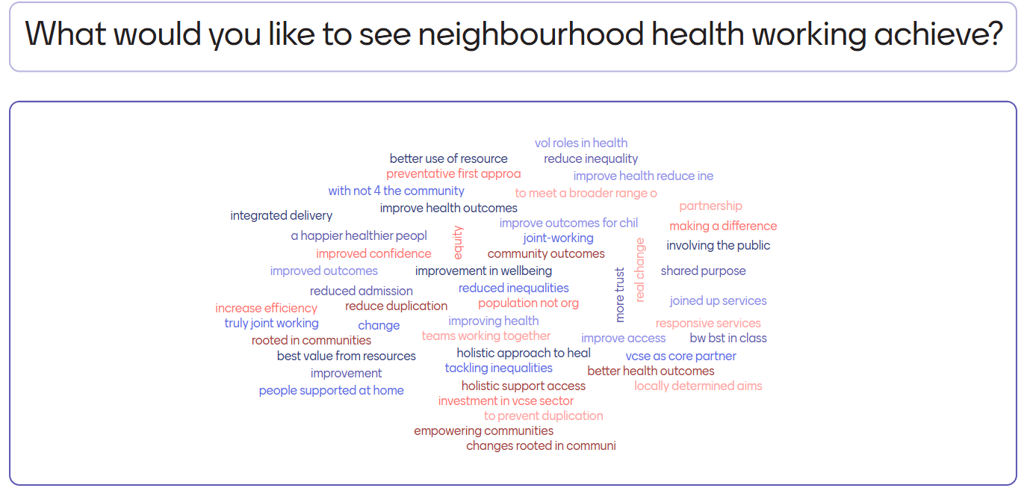
Residents and VCFS voices

Slide 7
The clinical priorities
Low/medium mental health across the board but significantly higher in bottom deprivation quintile = focused intervention in deprived areas (IMD 1-4)
Cardio-vascular disease in higher need Population Need Group (PNG) across all localities: end to end pathway, from primary prevention (e.g. community wellness) to secondary prevention (hypertension, cholesterol, heart failure). To start in Whitley, evaluate, learn and roll out across all areas
Respiratory Asthma and COPD focused within deprived areas (smoking is a key factor)
Frailty interventions for all high-risk red patients and in targeted interventions for moderate (amber patients) in deprived Reading wards

Slide 8
Low/medium mental health: focused intervention in deprived areas (IMD 1-4)
Why this priority has been picked: Depression is more prevalent in the most deprived areas, particularly amongst people with multiple long-term conditions.
What’s the problem to be solved?
Impact of depression on people’s daily life, including cognitive, physical and social impacts.
Depressed people who may be undiagnosed and therefore untreated.
Cultural issues, including perceptions about mental health and the presentation of symptoms.
What are the interventions that will make the difference?
Community outreach for mental health awareness.
Optimal use of existing therapies, including non-pharmacological methods
Preventative measures, such as life skills for positive mental health.
What will ‘good’ look like in 2 years time from the perspective of people?
Reduced depressive symptoms, new coping skills to prevent future depressive episodes, and improved overall well-being.

Slide 9
Cardiovascular disease: across all localities
Why this priority has been picked: CVD is the leading cause of death and disability.
What’s problem to be solved?
Unhealthy diet, lack of physical activity, smoking, and excessive alcohol consumption are significant contributors to CVD.
Unmanaged medical conditions such as hypertension and blood cholesterol.
What are the interventions that will make the difference?
Community support and engagement
Lifestyle changes.
Better identification those at high risk of CVD.
Optimum management of conditions.
MDT working.
Early diagnosis.
What will ‘good’ look like in 2 years time from the perspective of people?
Greater patient self management with knowledge and confidence to manage their own health.
Reduce the number of people developing CVD and prevent people from having CVD events.
Reduce ED attendances and emergency admissions for heart attacks and strokes

Slide 10
Respiratory conditions – Asthma and COPD focused within deprived areas (IMD 1-4)
Why this priority has been picked: Taken together, COPD and Asthma are more prevalent in the most deprived areas.
What’s the problem to be solved?
Impact on people’s daily lives including breathlessness, fatigue, muscle deconditioning, and mental health.
Particularly high prevalence of COPD in deprived areas.
Higher levels of smoking amongst people with COPD in deprived areas (43%).
Higher levels of obesity amongst people with Asthma in deprived areas (20%).
What are the interventions that will make the difference?
Smoking cessation (taking account of high level of digital inaccessibility amongst people with COPD).
Administration of the flu vaccine (baseline 68%).
Reduce variation in QOF compliance.
Improved integration of respiratory and obesity pathways.
Improvements in air quality and decent housing.
What will ‘good’ look like in 2 years time from the perspective of people?
Better management of respiratory conditions.
Reduction in ED visits for respiratory conditions.

Slide 11
Frailty interventions for high-risk red patients and proactive for Amber patients across all localities
Why this priority has been picked: Frailty makes older people extremely vulnerable to health crises, leading to an increased risk of falls, disability, hospital admissions, and dependence on others for care.
What’s problem to be solved?
Frailty problems including weight loss, weakness, exhaustion, slow walking speed, and low activity levels, leading to an increased risk of falls, immobility, hospital admissions, and a greater vulnerability to health changes from common events like infections.
What are the interventions that will make the difference?
Frailty MDT working involving a holistic person-centred approach.
What will ‘good’ look like in 2 years time from the patient perspective?
Reduced hospitalisation.
Better control over own health.
Living in own homes for longer.

Slide 12
BHFT/BW Primary Care Alliance working together
Previous work on IPASS (Pain and Spinal Clinical Assessment Service), Multi disciplinary teams (MDTs), Mental Health practitioners etc.
Jointly led two applications:
National Neighbourhood Health Implementation Programme (Berks West)
South-East Neighbourhood Health Accelerator Programme (Reading)
Shared leadership and chairing of the Berkshire West Neighbourhood programme.
Positive working relationships established.

Slide 13
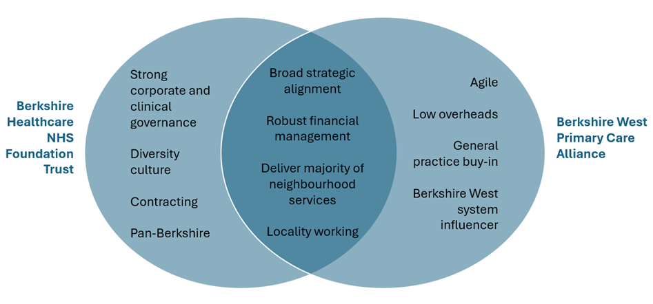
Benefits of working together

Slide 14
Delivering Neighbourhood Health Services
Partnership working
MDT working
Community engagement
Simplify care pathways
Co-production with people and communities
Neighbourhood working as BAU
Efficient use of resources
Build upon existing workstreams and good practice
Equal partners participating in the programme and direction of travel
PHM
Clear governance & reporting
Notes:
PHM
MDT working
Community engagement
Working together should simplify care pathways for patients and not create complexity
Co-production with people and communities is key and should be prioritised from the outset
Neighbourhood working should be a core part of BAU service delivery, not an add-on or project
Given level of financial and demand challenge, a key aim must be to use resources to maximum effect and support system sustainability, re-aligning existing resources where required
Neighbourhood working should help address inequalities and improve accessibility for all patient cohorts, working to reduce variations in health outcomes.
We should build upon existing workstreams and good practice wherever possible and not ‘reinvent the wheel’. Likewise, we should take account of previous successes/failures in planning our approach. Phasing is likely to be required – e.g. potential initial focus on NELs and CVD prevention.
Programme governance arrangements should be clear and all partners should feel equally able to participate in the work programme and influence its direction of travel.

Slide 15
The workstreams
Workstream | Lead | Expected outcomes | Work required | Impacts
Population health management | BWPCA/BHFT joint lead (Mark Davidson) | Standardised, system wide approach to PHM. Proactive segmentation and management of patient cohorts. | Establish a standard approach to PHM and segmentation across BHFT. Embed PHM in MDT working. | BHFT, Frimley Connected Care Team, RBFT, LAs, GPs, ICBs
Modern general practice | BWPCA lead | Deliver the Modern General Practice model. | https://www.england.nhs.uk/gp/national-general-practice-improvement-programme/modern-general-practice-model/ | GPs
Standardising community health services | BHFT lead (Helen Williamson) | Standard community service offer as part of the neighbourhood health service model. | Likely to be commissioner led. BHFT will want to be part of the review team. | BHFT, ICBs
Neighbourhood multidisciplinary teams (MDTs) | BWPCA/BHFT joint lead (Sri supported by Natasha) | Neighbourhood based MDT supporting complex patients and agreed cohorts. | BHFT internal MDT review. Partner in the West and East reviews. Implementation of any relevant recommendations. | BHFT, BWPCA, GP, LAs, RBFT, VCFS
Integrated intermediate care with a ‘Home First’ approach | BHFT lead (Sue White interim) | Short-term rehabilitation, reablement and recovery services (integrated intermediate care) taking a therapy-led approach (rehab or reablement care overseen by a registered therapist) working in integrated ways across health and social care and other sectors. | Review/evaluation of current BHFT Int Care offer. Partner in the review/evaluation of integrated (with partners) Int Care offer. | BHFT, GPs, RBFT, LAs, BWPCA, VCFS VCFSE
Urgent neighbourhood services | BWPCA lead | Includes alignment of UCR & VWs with a SPA. Aligned to the front door of ED - UTC & SDEC. | Alignment of UCR & VW covered in the CHS transformation programme. Alignment with UTC & SDEC here or CHS? | BHFT, BWPCA, EBPC (out of hours), RBFT, LAs VCFSE

Slide 16
BHFT services
Community nursing (all age)
Mental health community services, and crisis (all age)
Community paediatrician
Musculoskeletal (MSK) services and Community physiotherapy
Children and Young People’s Speech and Language Therapy (SaLT)
Audiology (adult and Children and Young Peoples’s)
Specialist Tissue viability or Wound care
Palliative Care and End of Life Care
Intermediate care (rehabilitation, reablement and recovery) services
Discharge to assess and home-first approaches
Urgent community response and virtual wards
Mental health care coordinators and dedicated mental health support in schools

Slide 17
Neighbourhood services
Example
At system
At borough
Reading
Wokingham
West Berks
Sub-borough interventions as required with some services aligned to this (in likelihood PCNs)

Slide 18
Reading: part of the regional neighbourhood health accelerator programme
Southeast Regional Programme that aims to support neighbourhood team development and understanding:
The Reading Neighbourhood team:
Nadeem Ahmed (clinical director)
Dan Haines (digital)
Rachel Spencer (VCFSE)
Paul Trinder (Public health analyst)
Bev Nicholson (Reading LA integration manager)
Helen Daw Team Lead (BHFT CVD nurse)

Slide 19
Final thoughts
Not just community based physical health services
Neighbourhood health services include physical health for adults and children and young people, and community based mental health services
Commitment to coproducing Neighbourhood Health Services
Teams could be working very differently
Neighbourhood health should not just be about joining up different bits of the NHS and local authority services
This presents an opportunity to think about how we design neighbourhoods to support ‘health’

