Slide 1
Royal Berkshire Connect
Jacqui Page
Patient Portal Programme Manager
May 2026

Slide 2
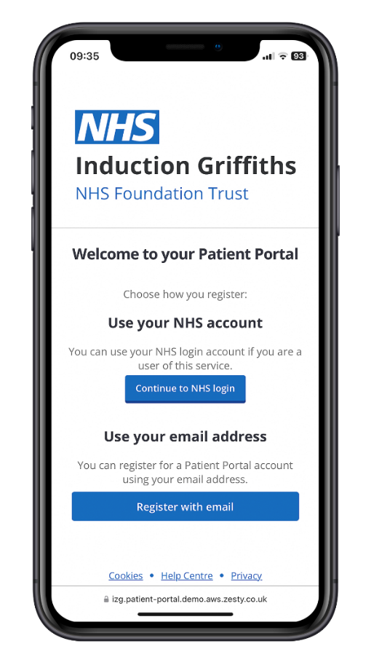
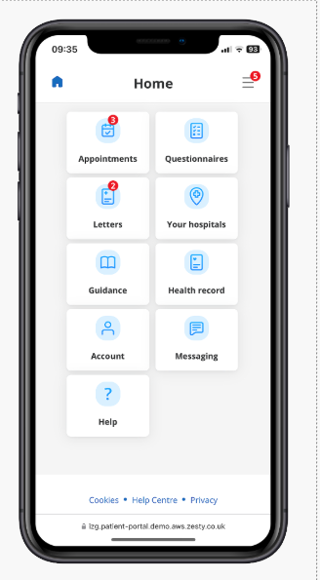
Royal Berkshire Connect (Patient Portal PPUK)
Current features May 2026
Outpatient Appointment management, including Radiology appointments
Confirming, changing and requesting appointments to be changed
Choosing paperless preferences
Receiving appointment letters through the portal
Patient leaflets available through the portal
Text reminders for appointments - 10 days and 3 days before appointment date
Sending text messages for validation of waiting lists
Patient questionnaires to be completed prior to appointments
Video appointments, peer to peer and group appointments
Pathology numerical results
All features available through the NHS App
New features to be rolled out from June 2026
Receiving clinical letters through the portal
Referral notifications, currently available in Physiotherapy
Patients receive confirmation through their patient portal that their referral has been accepted at the Hospital. Patients also receive relevant leaflets and questionnaires to be completed prior to appointment, through their portal.
Patient Initiated Follow Up (PIFU), will be available in Physiotherapy, Neurology and Gynaecology
If appropriate using the patient portal, patients are able to request a follow up appointment if they require one rather than have a standard follow up appointment
Remote Monitoring, will soon be available for ENT for Thyroid patients
Patients complete questionnaires through the patient portal and combined with test results this gives the clinicians the ability to monitor the patients condition remotely reducing the need for the patient to attend the hospital.

Slide 3
Royal Berkshire Connect:
All time – 2022 – 9th February 2026
279,264 first invites sent (unique patients)
186,296 patients registered on the portal (66.7% adoption rate)

Slide 4
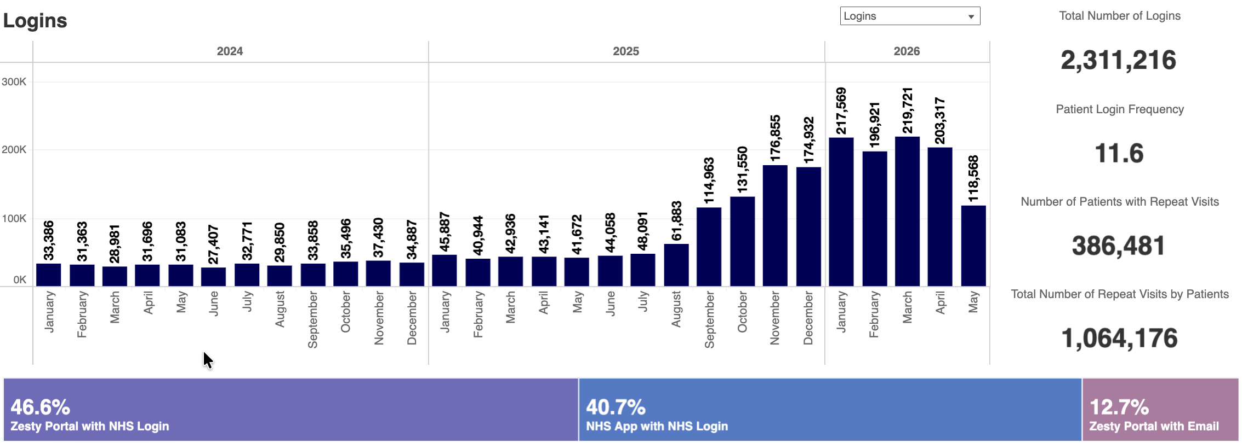
Patient Logins to Royal Berkshire Connect Portal

Slide 5
Current developments next 6-9 months
Clinical letters available in the portal
Referral notification roll out including indication of wait times and departmental information
Ability to cancel a referral digitally
Have a follow up appointment when I need it rather than time based follow up, (PIFU) roll out
Ability to reschedule or cancel appointments digitally
Digitally completing information prior to my procedure, pre op assessment.

Slide 6
Possible future developments The ask was to develop a 1, 3, 5 year roadmap
Reviewed the NHS 10 Year Plan and Trust Strategic Programmes
Looked at a patient journey and thinking about what needs they should be able to meet in 5 years time
Staff came up with the following:

Slide 7
💬 Appointment / Care Process using the portal
🗨️ “I want to access my information easily — without needing to register on the portal.”
🗨️ “Can I attend all related appointments on the same day?”
🗨️ “Help me find exactly where to go in the hospital — like Google Maps.”
🗨️ “Let me check in digitally on my portal when I arrive.”
🗨️ “I’d prefer more remote (virtual) appointments.”
🗨️ “I want all my condition and care pathway information in one place on my portal”
🗨️ “Notify me on my portal when it’s my turn to be seen in clinic.”
🗨️ “I should be able to book a parking space in advance.”
🗨️ “If I’m staying in hospital, let me choose my meals online.”
🗨️ “Allow me to share my inpatient location with my loved ones.”
🗨️ “I want to track my discharge progress.”
🗨️ “Let me give consent for procedures digitally.”

Slide 8
💬 After My Care
🗨️ “I want to message my care team easily”
🗨️ “Let me report my condition and be monitored remotely”
🗨️ “I need quick support if my conditions worsens.”
🗨️ “Give me a simple way to provide feedback on my care.”

Slide 9
Thoughts/Priorities/What’s missing
Take away:
What have we missed?
What would be useful that has not been mentioned

Slide 10
Thank you
Contact Details:
jacqui.page@royalberkshire.nhs.uk

